Slide 1
Docker & Kubernetes
Masukkan teks Anda di sini.

Slide 2
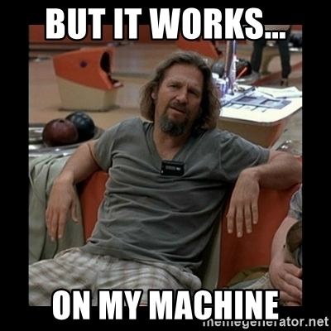

Slide 3
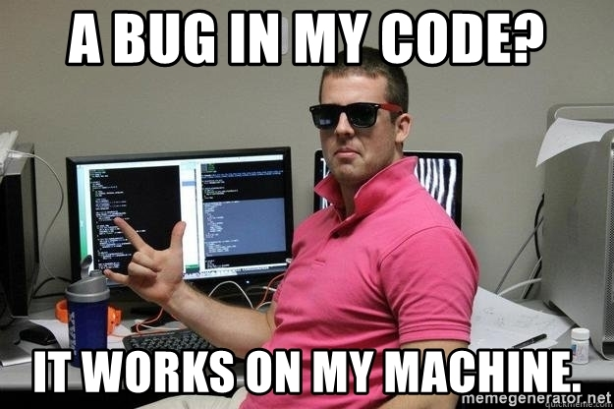

Slide 4
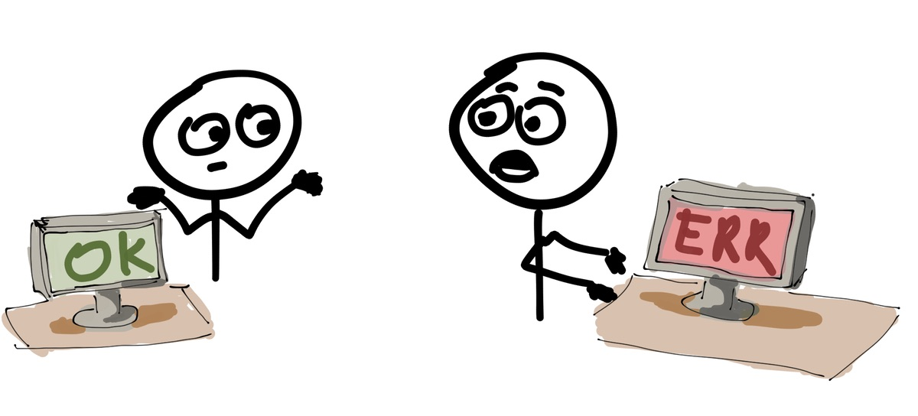

Slide 5
Deploying Application
WEB SERVER
DATABASE
APPLICATION
LIBRARY
RUNTIME APP
OPERATING SYSTEM
SERVER

Slide 6
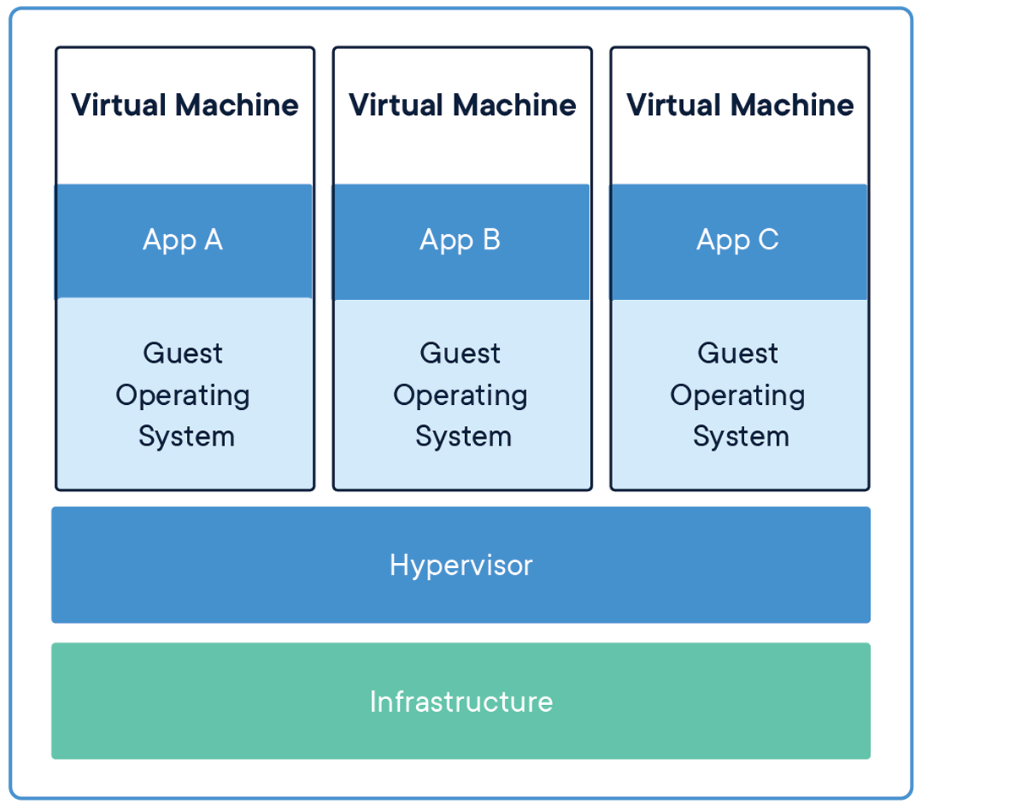
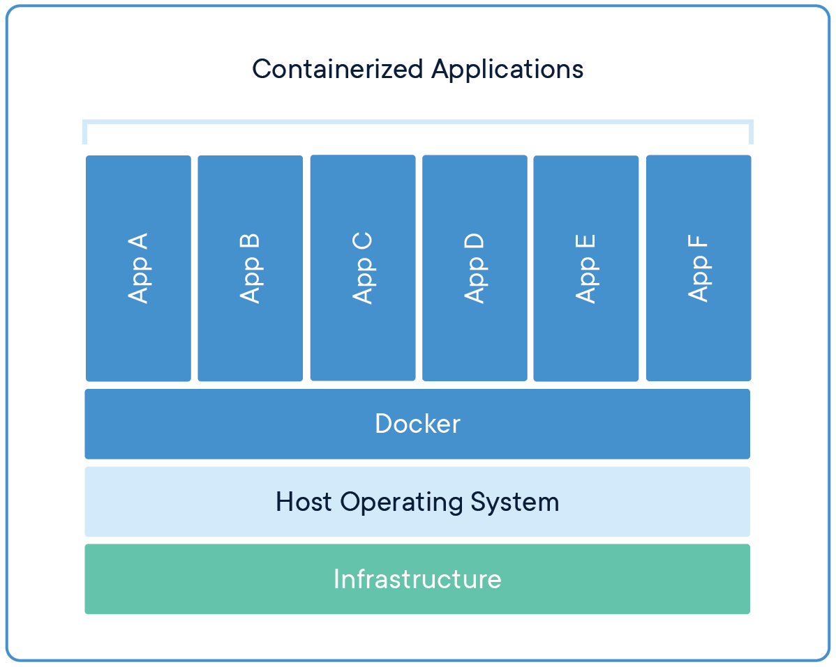
Containers vs Virtual Machines
source: docker.com

Slide 7
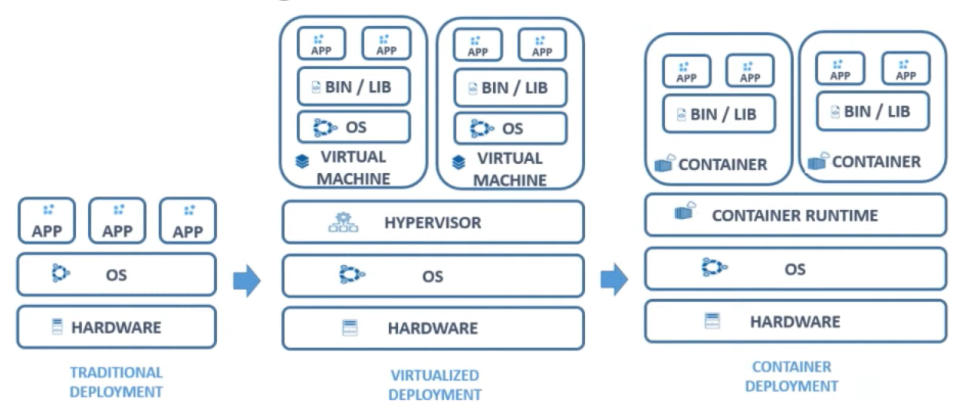

Slide 8
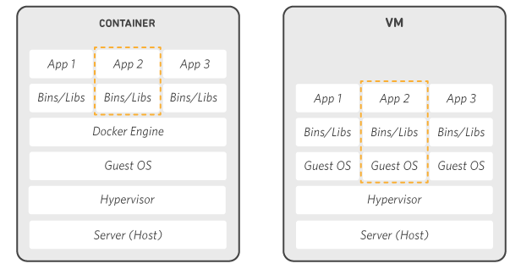

Slide 9
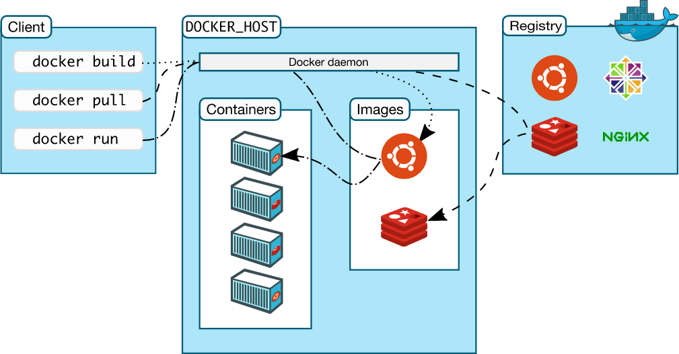
Arsitektur Docker

Slide 10
Install Docker
https://docs.docker.com/get-docker/

Slide 11
Container Registry

Slide 12
Container Registry
Docker Hub : https://hub.docker.com/
Google Container Registry : https://cloud.google.com/container-registry
Amazon Elastic Container Registry : https://aws.amazon.com/id/ecr/
Quay Container Registry : https://quay.io/
etc.

Slide 13
Docker Image

Slide 14
Container

Slide 15
Praktik
docker image docker container
docker pull nginx:latest
docker run -d -p 8181:80 --name nginx nginx:latest

Slide 16
Dockerfile
FROM golang:latest
WORKDIR /app
COPY . /app
CMD ["go", "run", "/app/main.go"]

Slide 17
Docker Build, Run
docker build -t swadharma/goapp:latest .
docker push swadharma/goapp:latest
docker pull swadharma/goapp:latest
docker run -d -p 8181:8181 -n sms swadharma/goapp:latest

Slide 18
Docker compose
Praktek...

Slide 19
Membersihkan data sampah
docker system df
docker system prune -a --volumes

Slide 20
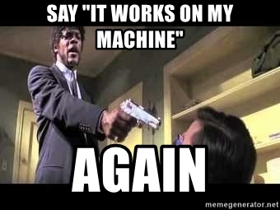

Slide 21
Next
Kubernetes

Slide 22
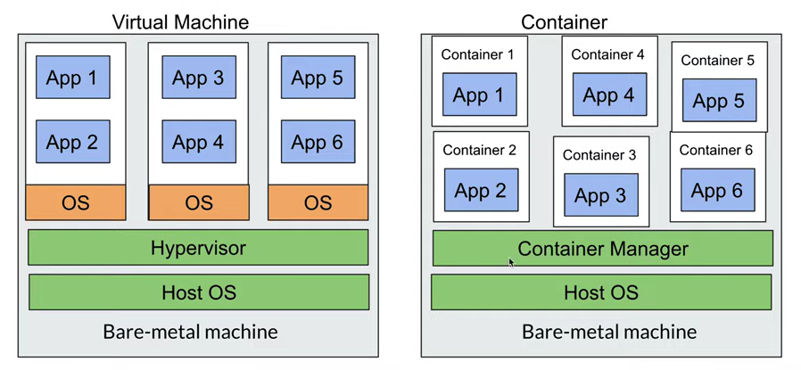
Kenapa Kubernetes
Trend microservices
Trend containerization

Slide 23
Alur Kerja Kubernetes
Kubernetes Workers / Node
Config File
2
Kubernetes Master
4

Slide 24
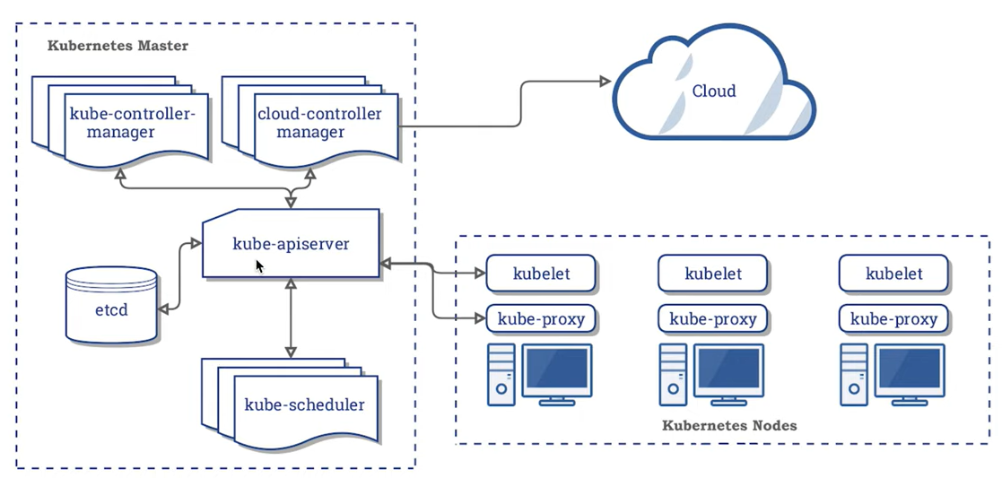
Arsitektur Kubernetes

Slide 25
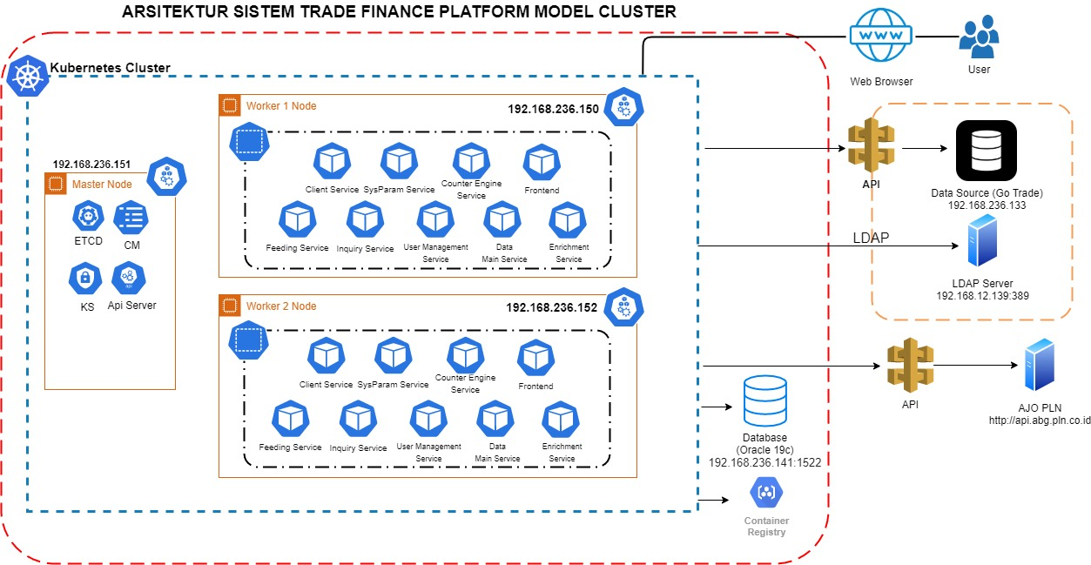

Slide 26
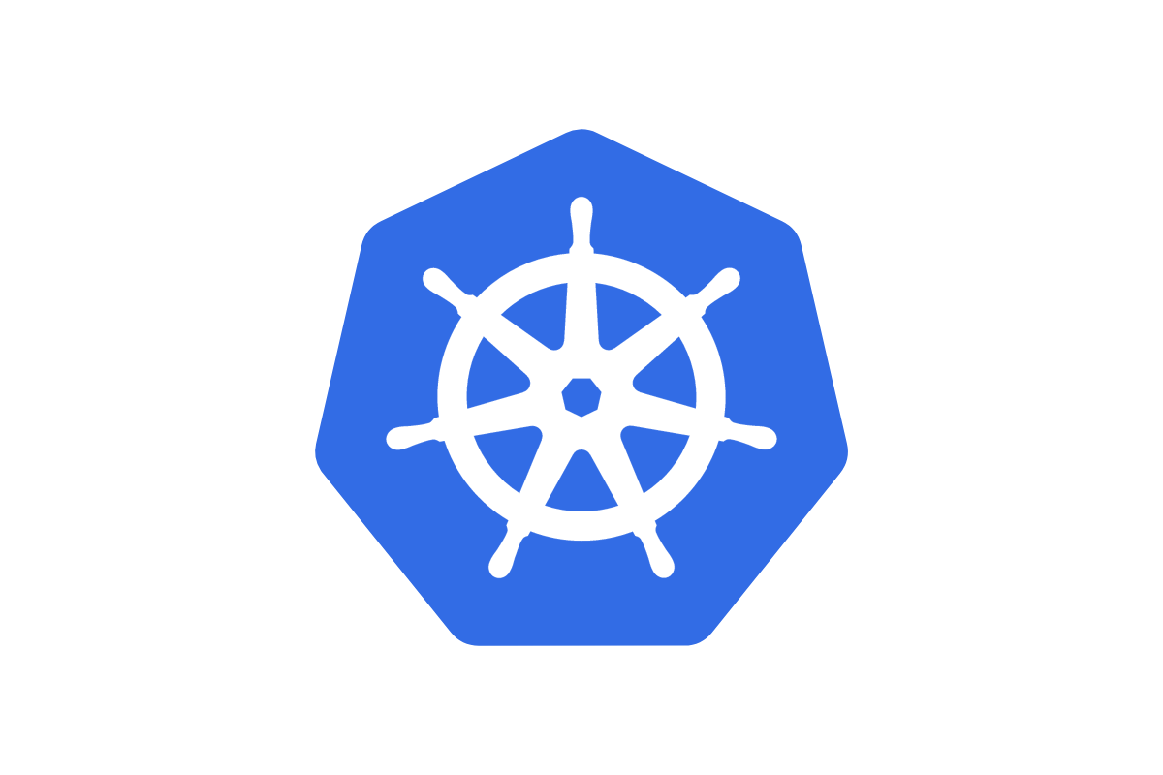

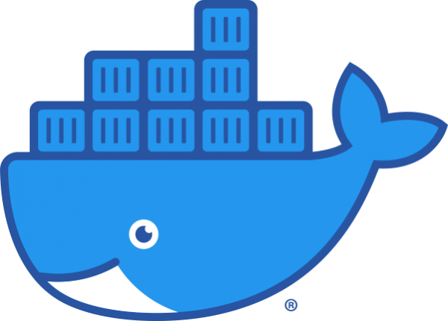
Wait, Docker is deprecated in Kubernetes now?
Is it true?
Yes, it is true. Docker is now deprecated in Kubernetes.

Slide 27
Terima kasih.
@meziaris - meziaris@gmail.com - https://mezi.space - https://mezi.web.id

